Slide 1
CS 4423
Game Development
Course Introduction

Slide 2
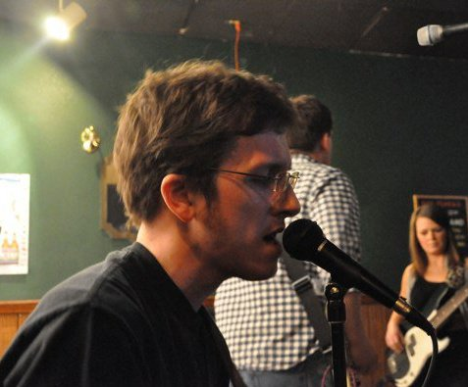
Welcome!
My name: John Quarles
  Pronounced like “quarrels”
  You can call me John or Dr. Quarles , Professor Quarles, Dr. Q , or Q
3 unique things about me
  I have Multiple Sclerosis
  I do research in Virtual Reality Games
  I am a musician
      victimcache.com
      carbonrapture.com

Slide 3
Class Info
Location: NPB 1.238 Time: TR 2:30-3:45 Professor: John Quarles Office: NPB 3.322 Email: jpq@cs.utsa.edu (Put GD in the subject) | Office Hours: • T 1:30 - 2:30 • R 1:30 - 2:30 • By appointment (email)

Slide 4
Course Schedule
See the COURSE SCHEDULE link on BB
  Use the link, not the calendar

Slide 5
Syllabus
See the syllabus on BB
  40% individual programming assignments (3 assignments == 3 mini games)
  50% final project (team game project)
  10% class participation (almost every class there will be problems to solve in groups to stimulate your thinking - 5% of this may be to participate in a research study).

Slide 6
Final Project Information
See the Final Project Description on BB

Slide 7
Assignments
I want you to have a nice portfolio in case you want to be a game developer
  You should be able to put each assignment on your resume as a game you implemented
  Each assignment will be about the size of a mini-game.
  3 mini games + 1 final game = 4 games
  Sounds daunting but Unity is a RAPID game development engine

Slide 8
Extra Credit Assignment 1
Adds +1 to your final grade
Introduce yourself to me
  - e.g., before/after class, during OH, when you see me around campus, etc.
Tell me 3 unique things about yourself
  This helps me to remember your names and tailor my teaching to you more effectively.
  Due: sometime before the end of the semester, preferably SOON!

